Slide 1
A Full and Equal Order
By Margaret Ann Crain
Deacon, Northern Illinois Conference
Retired from Garrett-Evangelical Theological Seminary

Slide 2
Diakonia and methodism go together!
John Wesley articulated a theology which paired personal holiness with social holiness.
We seek to know God in Christ but we never stop trying to transform the world in God’s will.
How leadership for diakonia is defined and embodied in methodist denominations has evolved several times.
Currently, the mission of the UMC is “to make disciples of Jesus Christ for the transformation of the world.”

Slide 3
Lucy Rider Meyer The Chicago Training School 1885
Photo used with permission from Garrett-Evangelical Theological Seminary.

Slide 4
Photo used with permission from Garrett-Evangelical Theological Seminary.

Slide 5
Deaconesses
1888
The General Conference of The Methodist Episcopal Church approved the office of deaconess.
Photo used with permission from Garrett-Evangelical Theological Seminary.

Slide 6
The United Methodist Church
Born in 1968
Union of The Methodist Church and
Evangelical United Brethren

Slide 7
1968-The Uniting Conference Dr. Albert Outler, preaching
Used with permission from the General Commission on Archives and History

Slide 8
The United Methodist Church
Basically, a representative democracy with three branches:
Legislative – General Conference
Executive – the bishops and the General agencies
Judicial – the Judicial Council
How diakonia fits into the power structure and the economic structure is critical!
Even before the formation of the new denomination in 1968, some in the church envisioned a diaconal office with a clear place in the leadership, structure, and budget of the church.

Slide 9
Ministry Study Commission 1972-1976
Clarified that all Christians are called to ministry by their baptism
Created the office of diaconal minister, replacing the consecrated lay worker

Slide 10
The UMC has had a confusing plethora of deacons, diaconal ministers, deaconesses, etc.
When the office of diaconal minister was created by the 1976 General Conference, we also had sequenced ordination for our elders (presbyters) who served as deacons before their full membership as elders.
The deaconess office was still in place.
Diaconal Ministers were laity, but were consecrated to a lifetime ministry. To all intents and purposes, they looked more like clergy, thought more like clergy, and felt called to be clergy.
Diaconal ministers and their allies continued to work toward a permanent deacon, ordained, and a full and equal order.

Slide 11
ThisarrativThsiolo asking these questions:
Why does the Church exist? What is the mission of the Church?
How can the Church join in the misseo Dei?
What kind of leadership is needed to accomplish its purposes?
Primary Questions:

Slide 12
1996 General Conference made a big decision!
The United Methodist Church
in
Denver, Colorado

Slide 13
The Order of Deacon
Ordained to Word, Service, Compassion and Justice
Full clergy rights
Appointed by the Resident Bishop
Almost a full and equal order!

Slide 14
Unresolved issues:
Unconscious sexism limits deacons, mixed in with misunderstanding of “service”
Lack of awareness of systemic racism
Lack of financial support for missional ministries that address the transformation of the world through compassion and justice
Deacons have not yet reached a critical mass and thus are not “seen” at times.
Lack of missional imagination in the Council of Bishops

Slide 15
Dr. Jerome King Del Pino former General Secretary of GBHEM
Bishops don’t want to have anything to do with empowering and enabling the annual conference to provide enough money to ensure that deacons are doing justice. I wish that every conference could claim they’ve got deacons who are assigned to city councils or state legislatures. I wish they could say, “We’ve got deacons appointed to be in the public square and in the centers of power where the questions of justice are addressed.”

Slide 16
Compassion is nice, but it is not enough!
Deacons must seek justice.

Slide 17
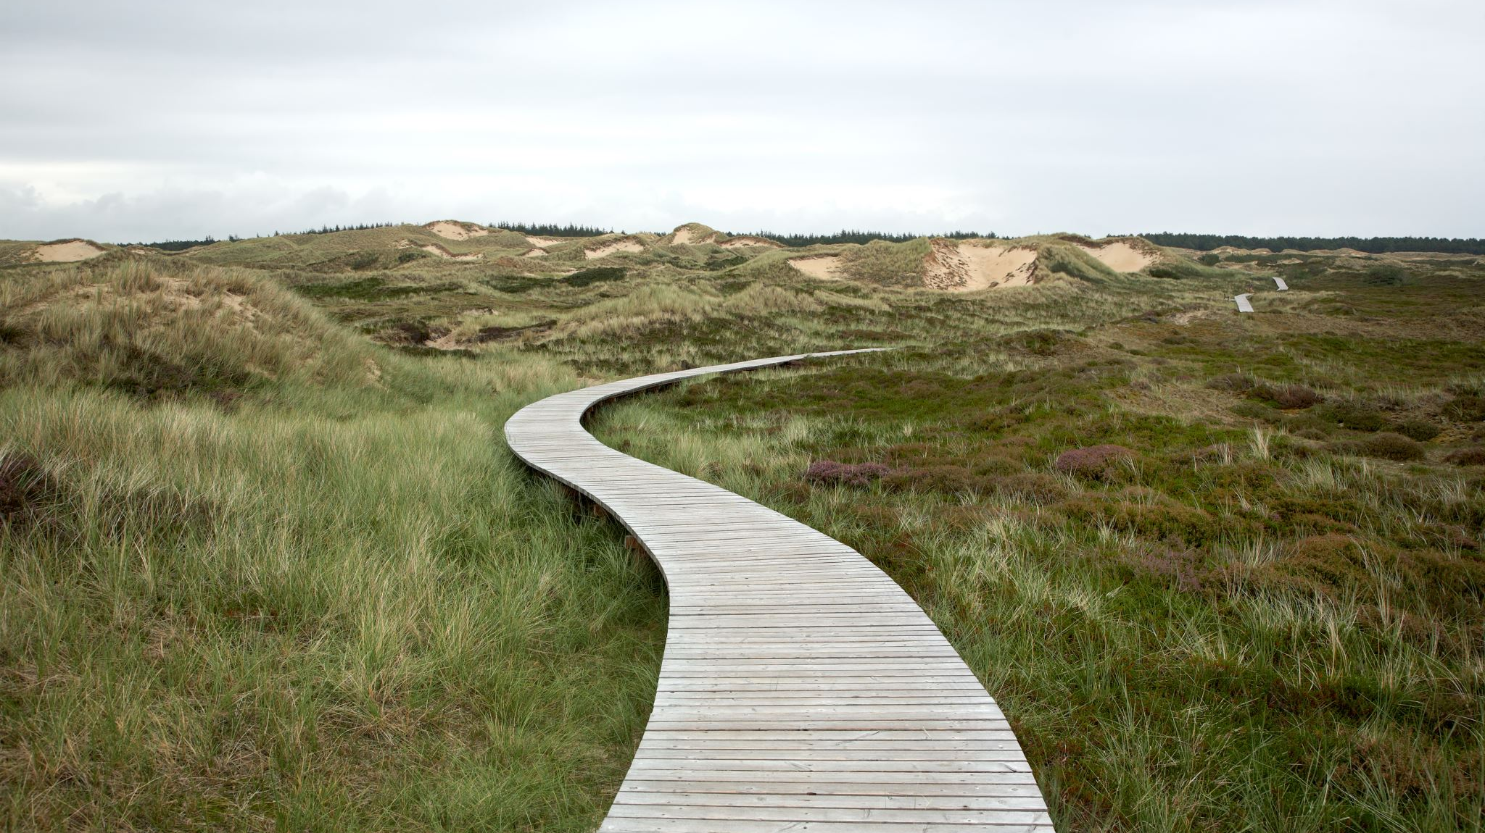
Already, But Not Yet:
25 Years of the United Methodist Deacon:
Almost a Full and Equal Order

Slide 18
